Slide 1
MSR Gas Detection
PG2

Slide 2
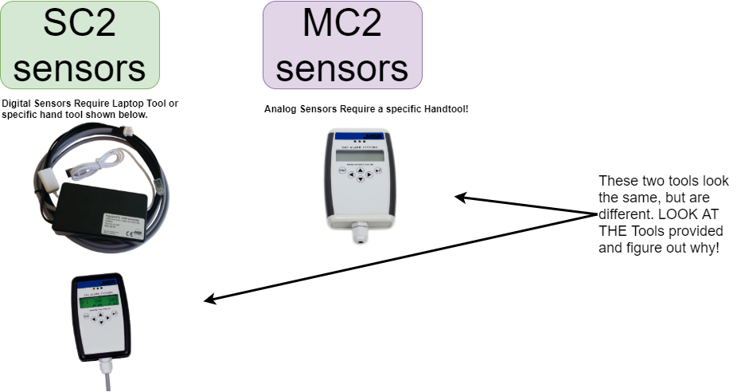
Sensor Info

Slide 3
What is the difference between Digital and Analog?
Lets list some advantages and disadvantages
Digital Sensors!
Very Accurate
Very easy to calibrate
Figuratively cannot fuck it up! ☺
Analog Sensors!
Difficult to calibrate, require adjustment of input and output

